Slide 1
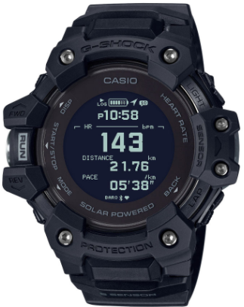
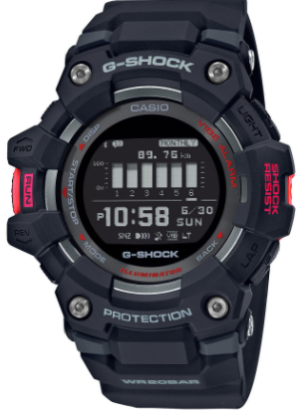
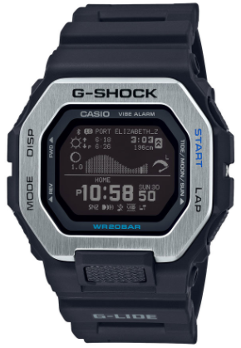
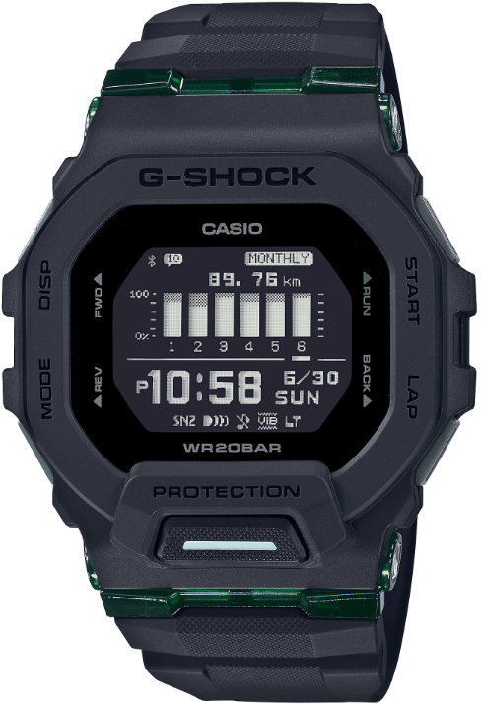
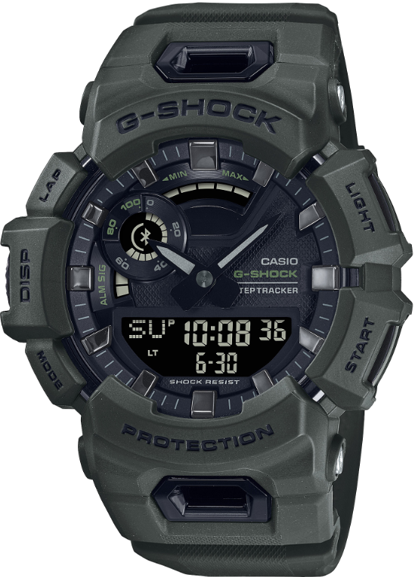
“G-SHOCK MOVE” App Support Manual (Part2)
GBD-H1000
GBD-100
GBX-100
GBD-200
GBA-900
as of December 2022

Slide 2
2
Table of contents
Login to G-SHOCK MOVE 3 - 5
How to return to the initial settings 6 - 7
Watch Software Update 8 - 9
About Notifications 10 - 11
Information about data retention period 12
Training Functions
- GBD-100 / GBX-100 / GBD-200 13
- GBD-H1000 14
About linking to external applications 15 - 16
Precautions when measuring Heart Rate 17 - 19
About Calorie Measurement 20 - 22
Precautions for Indoor activities 23
About Tide Table 24

Slide 3
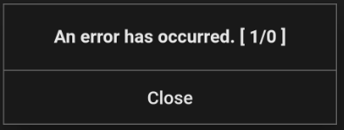
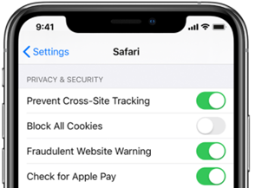
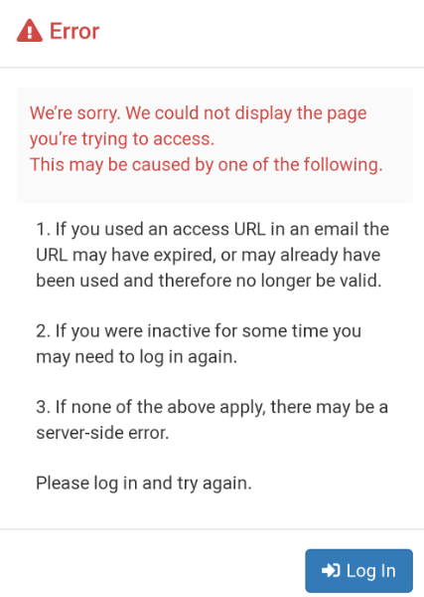
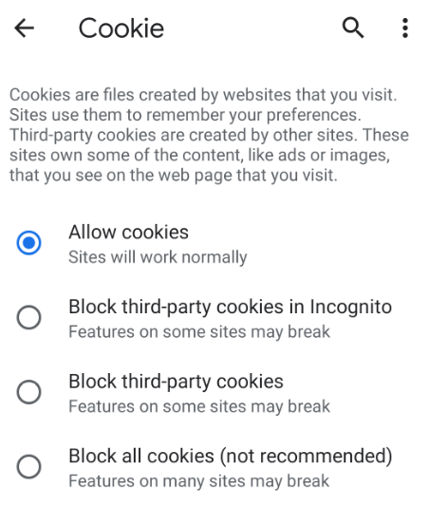
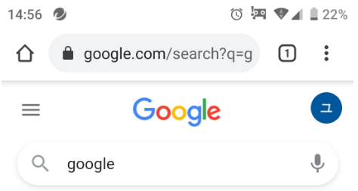
Login to G-SHOCK MOVE
3
Login error
Please make sure that your browser's "cookie settings" are enabled.
After checking it, uninstall the app, restart the smartphone, reinstall the app and then try the login operation again.
How to confirm “cookie settings”.
1. Settings
2. Safari
3. Block All Cookies
4. Off
1. Open the Chrome
2. Tap the icon in the upper right
3. Settings
4. Site settings
5. Cookie
● If the following message appears
< For iPhone Safari browser>
4.
Error code 【1/0】
< For Android>
4.
Error message

Slide 4
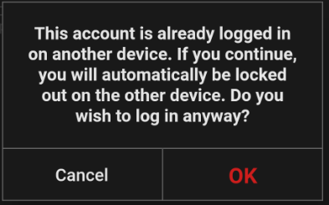
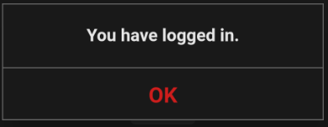
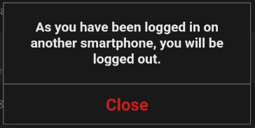
Login to G-SHOCK MOVE
4
Login error (2)
If you have two smartphones and have the app installed on both,
you may see this message when you log in on one device and operate G-SHOCK MOVE app (include after log out)and then try to operate it on the other smartphone.
<Smartphone 1>
<Smartphone 2>
It may be displayed even after changing the smartphone model.
It may occur if there is a lot of data at the time of download, so please advise the following contents.
Uninstall the app and install the app again.
Perform the operation at another time.
● If the following message appears

Slide 5
Login to G-SHOCK MOVE
5
☆ Items to check when customers cannot log in
- Whether customers created CASIO ID correctly
If customers created CASIO ID correctly, they should have received the completion mail.
- Confirm the login status. (A or B)
A : Customers are trying the login operation for the first time after creating the CASIO ID. (That is, the first login)
B : Customers could log in until recently and suddenly became unable to log in.
- Is the address and password combination correct?
- Is it possible to log in from the following address on PC?
https://cws.casio-intl.com/landing.html
- Confirm if browser's "cookie settings" are enabled. (Please refer to page 3 )
- Whether customers performed the following operations.
Uninstall the app / Restart the smartphone / Install the app again / Try login operation again
- Details of the error message.

Slide 6
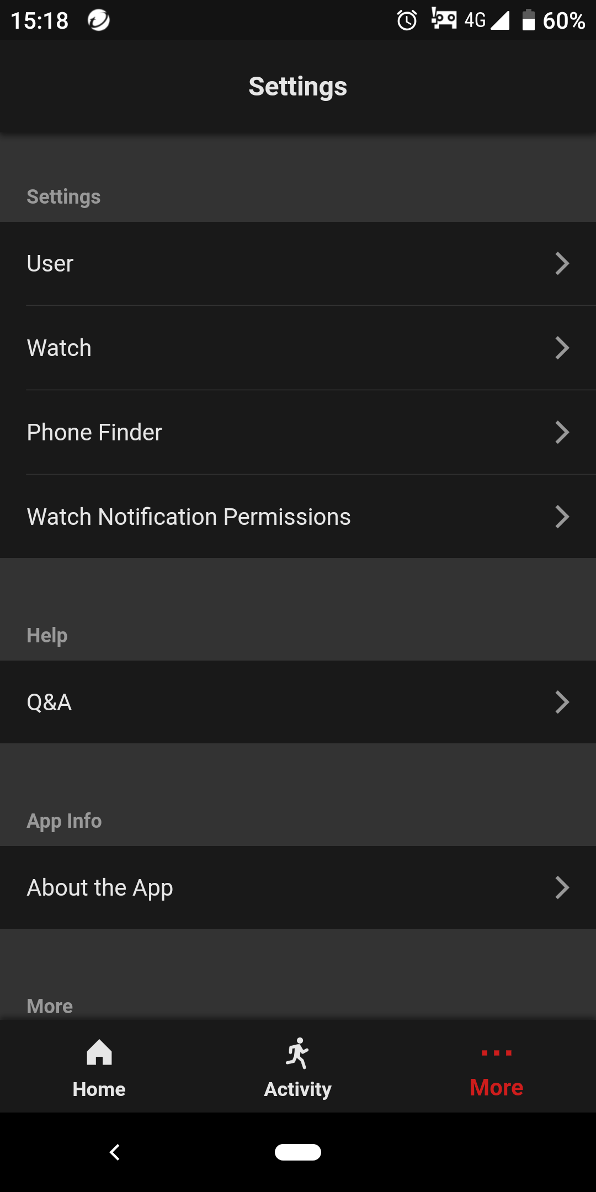
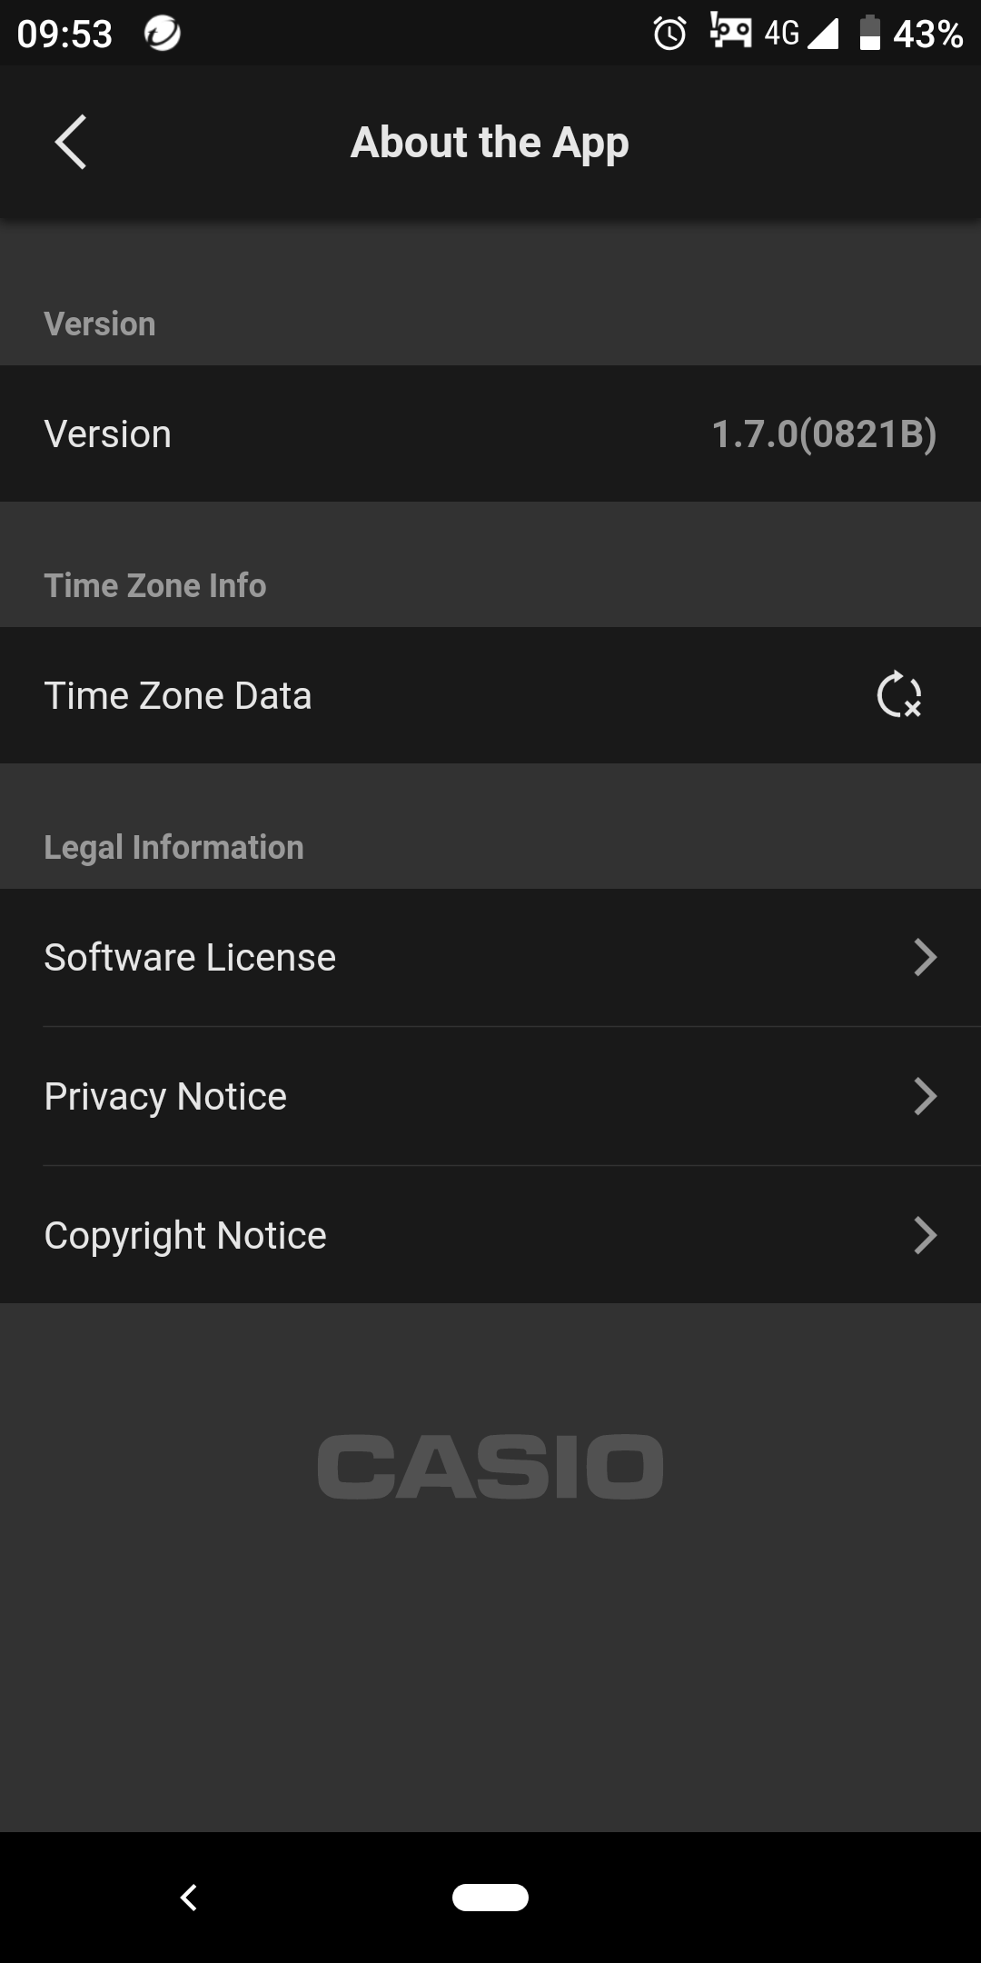
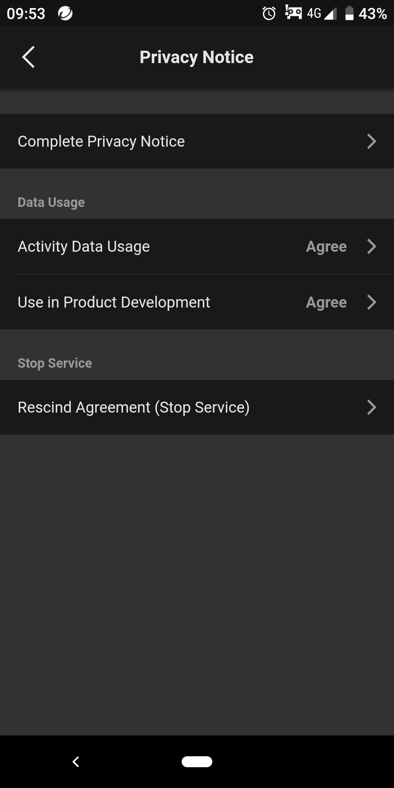
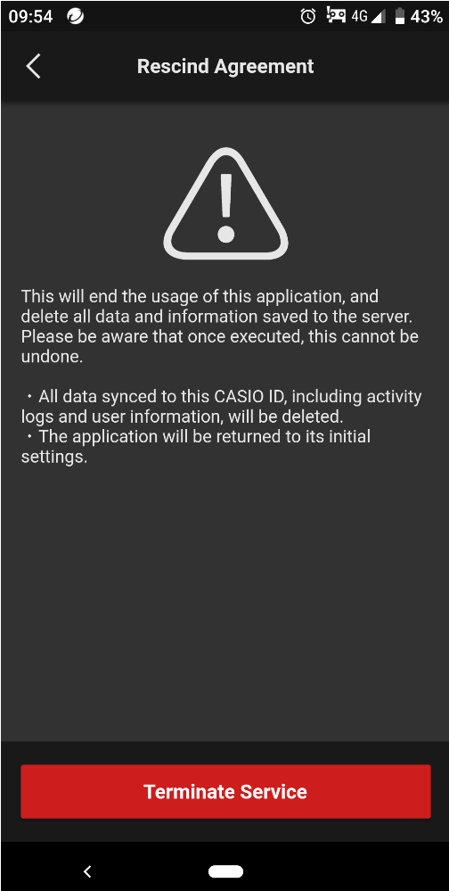
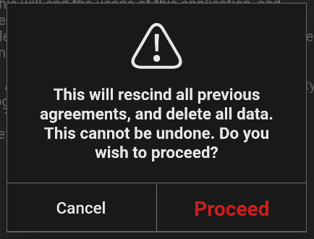
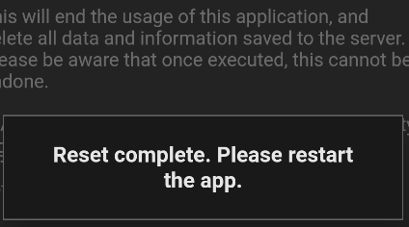
How to return to the initial settings
6
<Application>
※If you do the initial setting operations, the data on the app server (activity data, lifelog data, profile, etc.) will all be deleted.
Tap “Proceed”.
②①
①
Tap “More” and then tap “About App”.
Tap “Privacy Notice”.
Tap “Rescind
Agreement (Stop Service)”.
Tap “Terminate Service”.

Slide 7
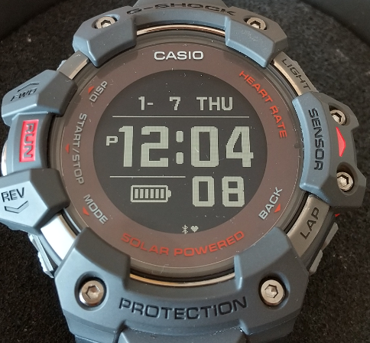
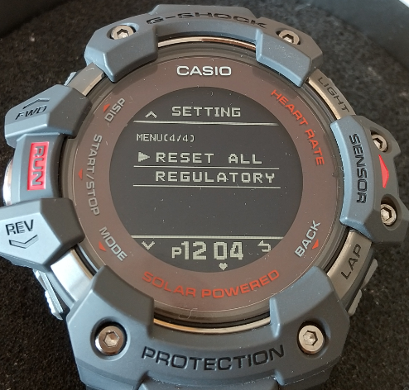
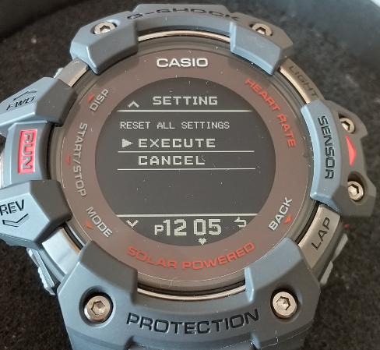
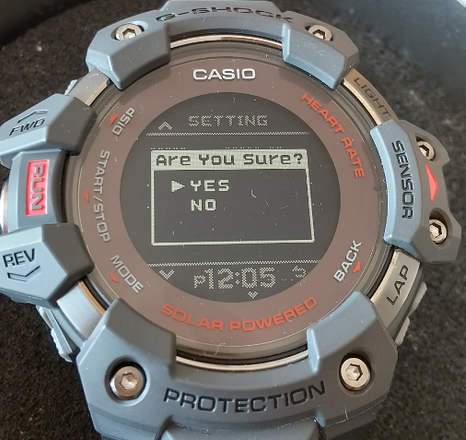
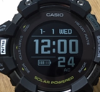
How to return to the initial settings
7
< Watch >
※ (GBD-H1000 only)
Hold down the upper left button for at least 2 seconds.
Press the upper or lower left button to change the setting item and select “RESET ALL SETTINGS”.
Press the middle button on the left. (RUN button)
Select “EXECUTE”.
Press the middle button on the left. (RUN button)
Select “YES”.
Press the middle button on the left. (RUN button)
It takes about 5 minutes to complete the process.
When completed, all data will be erased and the date and time will be 12:00 on January 1st

Slide 8
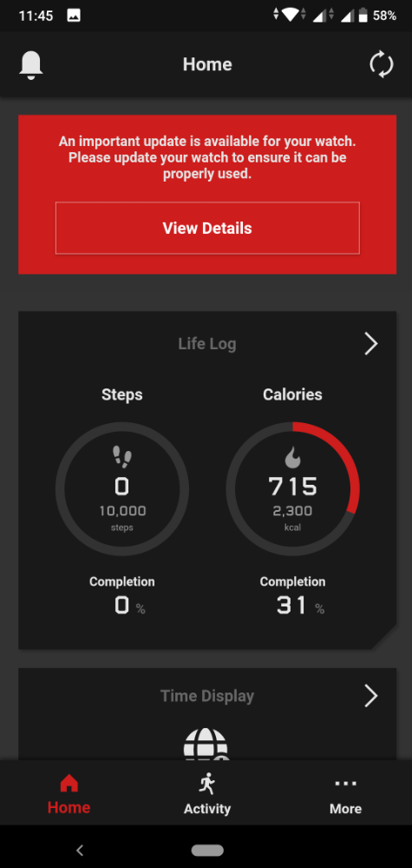
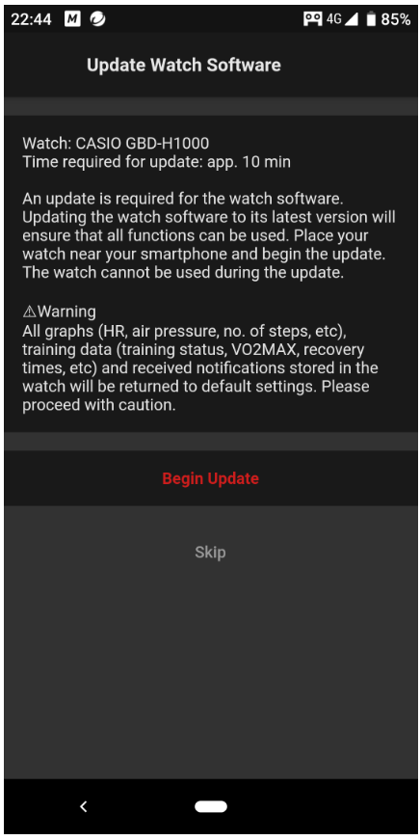
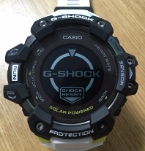
Watch Software Update
8
If the following message is displayed on the app, you need to update the watch software.
Keep the pairing status.
Tap “View Details”.
Place your watch by your side and tap “Begin Update”.
→It will take a few minutes to complete.
You can not use the watch during the update.
*If the battery is low, charge it before proceeding.
Display during being updated
We have not disclosed the details of the update contents.
Unfortunately, we cannot answer even if the customer asks.

Slide 9
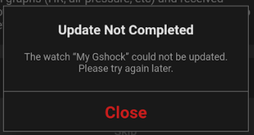
Watch Software Update
9
If the update fails, try the following.
Leave the watch off your wrist.
Leave the watch in Timekeeping Mode overnight without any operations. (up to 24 hours)
* Overnight means 0:00 to 5:00 local time.
* If you can't update after leaving it overnight, try leaving it for up to 24 hours.
* Because it is necessary to erase the Flash of the time zone information that failed to rewrite.
- Update the watch again keeping in Timekeeping mode.
If you try the operation under the above conditions and fails every time, there may be something wrong with your watch.
You need to check it.
Please consult with the service engineering section if necessary.
The latest watch software version (as of July 2021)
Watch | GBD-H1000 | GBD-100 | GBX-100
Software version | 09 | 06 | 04

Slide 10
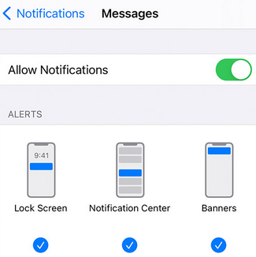
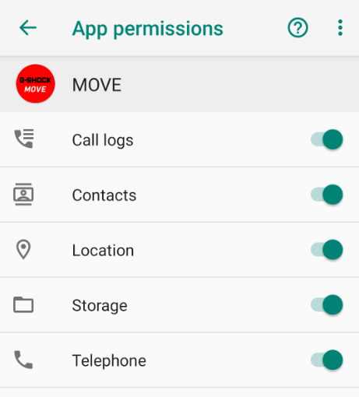
About Notifications
10
If you do not receive notifications, please confirm the following points first.
● Notification settings for smartphones
・Settings → Notifications - Show Previews - select "Always" or "When Unlocked"
・Settings→ Notifications
＊ Please check the settings for apps that do not receive notifications.
example) Settings - Notifications - WhatsApp
Settings - Notifications - Phone
Turn on all "Allow Notifications", "Lock Screens", "Notification Center" and "Banner".
・Settings → Apps and notifications → Select “MOVE” app → Permissions
→ All permits such as “Telephone” are ON.
* Please also check other apps that do not receive notifications, such as the "email app".
・Special access notification settings (model dependent)
・Settings → Special app access → Notification access → MOVE → ON
※ “Special app access" is displayed when you display the settings of your smartphone
and search for "special access" or "special app access" using the search mark.
※The displayed contents differ depending on the smartphone and OS version,
so please check with your carrier or smartphone manufacturer for details.
< iPhone>
< Android>

Slide 11
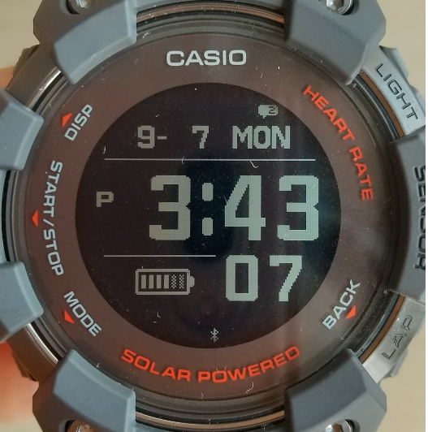
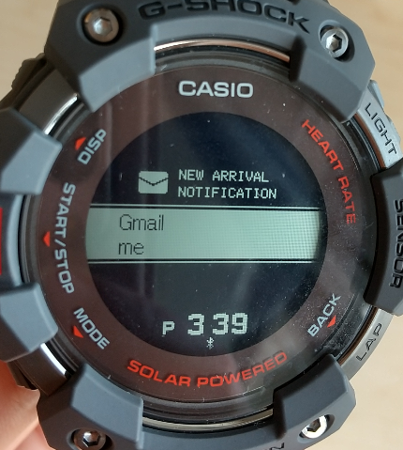
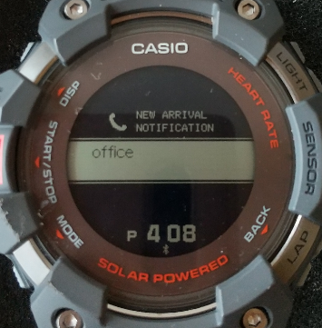
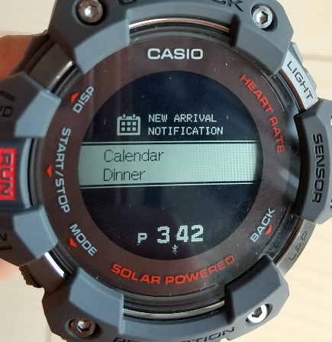
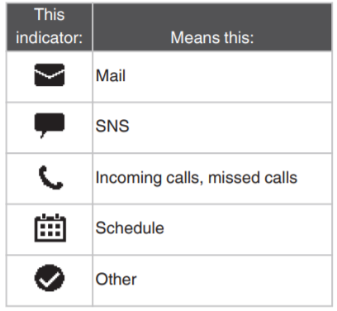
About Notifications
11
< Reference URL >
https://support.casio.com/en/support/faqlist.php?cid=009001020
https://support.casio.com/en/support/faqlist.php?cid=009001022
https://support.casio.com/en/support/faqlist.php?cid=009001023
・Connections and notifications in general

Slide 12
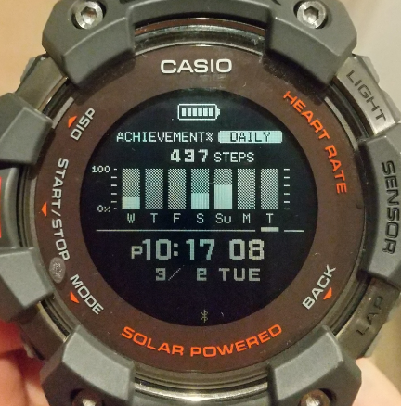
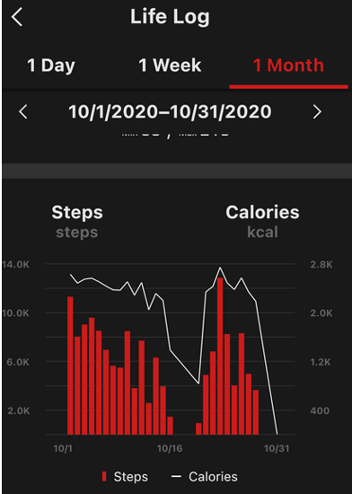
Information about data retention period
12
●Period during which the step counts and measured distance data can be retained on the watch side
Step Counts data : Hourly data for up to 3 days, Daily data for up to 7 days
Distance data : Up to 6 months (aggregated monthly)
●Watch data retention period is 3 days.
If you do not connect the watch to the app for 3 days or more,
you will not be able to transfer data even if there is data on the watch.
<Example>
Even though you wore a watch every day and walked, there are places where there is no data as shown by the white arrow.
A possible cause is that you did not transfer the data for the day indicated by the white arrow within 3 days (you did not connect to the app).
2/1/2021–2/28/2021
※Not to lose your data, please connect the watch and the app frequently and keep the status to make it transferable.

Slide 13
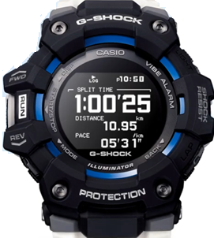
Training Functions
13
GBD-100 / GBX-100 / GBD-200
GBX-100, GBD-100 and GBD-200 calculate and display distance, speed, pace, etc. by accelerometer.
The degree of error depends on the difference between the estimated value and the actual stride length.
Therefore, an error may occur with respect to the actual distance.
The distance is calculated by multiplying the number of steps taken based on the stride estimated from the height of the customer. (Steps x Stride length)
Therefore, if the estimated stride length is different from the actual value, an error will occur in the distance, and the longer the distance, the larger the error.
In addition, it is judged whether it is walking or running by the watch side, and the stride changes according to the judgment.
＊Generally, the stride is longer when running. In other words, for the same number of steps,
the distance is longer when running than when walking.
In order to reduce the error, the stride is corrected by running with the smartphone
GPS turned on and connected to the G-SHOCK MOVE
(even if you do not have the smartphone the next time you run),
it will be closer to the actual distance.
In addition, if the customer's running pace increases and the stride changes
due to repeated training,
an error will occur again, so in that case it is recommended to run
while connected to the app again.

Slide 14
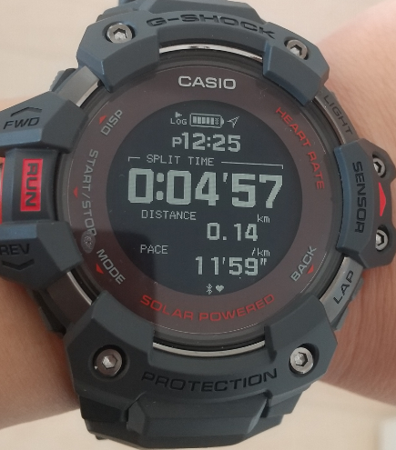
Training Functions
14
GBD-H1000
GBD-H1000 calculates and displays distance, speed, pace, etc. using GPS or accelerometer.
You can receive more accurate results by using GPS.
Moreover, please confirm the following contents before training.
＜ Preparation before training＞
Launch the app "G-SHOCK MOVE" and connect to GBD-H1000.
→By connecting to “G-SHOCK MOVE” before starting training, GPS trajectory information
(ephemeris information) will be sent from the app to the watch. Since the watch knows the ephemeris information in advance, it becomes easier
to capture GPS before and during measurement.
*You do not need to carry a smartphone while running.
＜ GPS reception before measurement start＞
Outdoors where the sky is visible and not blocked by high-rise buildings,
trees, or other objects, orient the watch so its face is pointed straight up at the sky. After the GPS completion message "GPS CAPTURE" is displayed,
press the start button to start measurement.

Slide 15
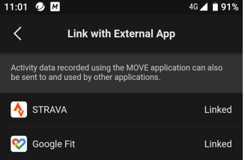
About linking to external applications
15
Timing of syncing to third-party apps
When the MOVE app became the foreground
When the Synchronization operation was performed
If the G-SHOCK MOVE data is not synced to external applications, please confirm the following points.
1. Check if it is linked
[More – Link with External App]
2. Confirm if the data is displayed in the Move for web not only the G-SHOCK MOVE app
of the mobile version. (https://cws.casio-intl.com/landing.html)
*Normally, data synchronization with the MOVE for web is performed immediately after the data is
transferred from the watch to the G-SHOCK MOVE of the mobile version.
3. Confirm if Bluetooth connection is established.
Linked
Linked
< Reference URL >
https://support.casio.com/en/support/answer.php?cid=009001020008&qid=97916&num=1
https://support.casio.com/en/support/answer.php?cid=009001020008&qid=97917&num=2

Slide 16
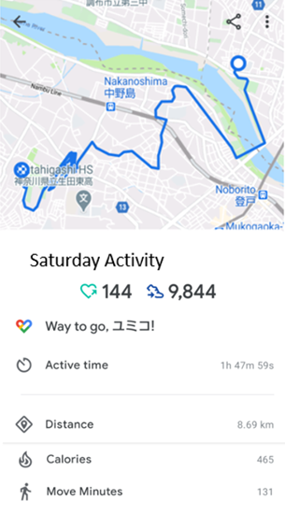
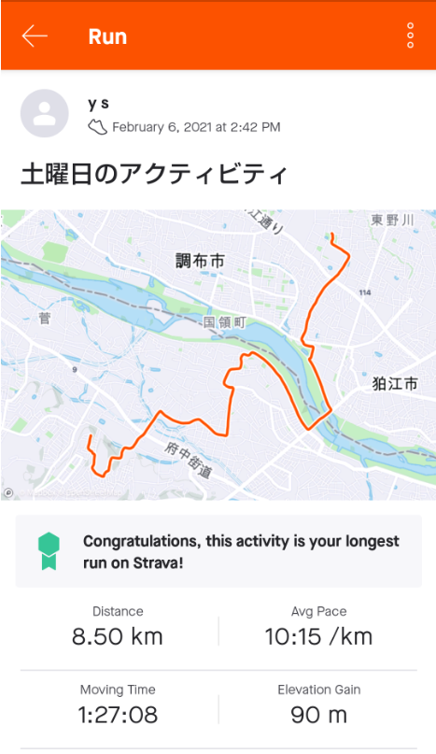
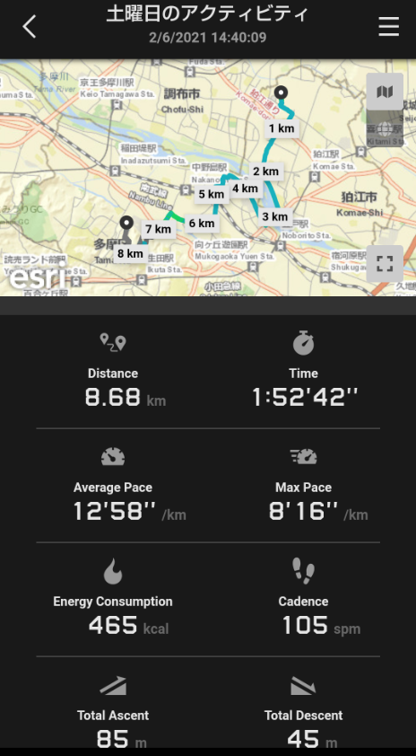
About linking to external applications
16
<The number of steps displayed in "Google fit“, "STRAVA“ and "Apple Health“>
Even if you link external apps to G-SHOCK MOVE, the number of steps displayed
in "Google fit", "STRAVA", and "Apple Health" does not exactly match.
Since Apple Health etc. have a function to acquire the number of steps with the acceleration sensor
built in the smartphone, it may not match MOVE.
The number of steps will be displayed depending on how the receiving application side, which is the parent, processes.
<Display example in each app >
Saturday Activity
2/6/2021 14:40:09
Yumiko!
G-SHOCK MOVE
Google Fit
STRAVA

Slide 17
Precautions when measuring Heart Rate
17
GBD-H1000
●Heart rate measurement under water
The optical sensor measures the heart rate by emitting and receiving light from the LED.
Underwater, water may get in between the sensor and your arm, which may prevent accurate heart rate measurement.
●Heart rate measurement when sprinted 50m or 100m
Heart rate measurements are average heart rate values calculated from data over a period of time.
Therefore, the change in heart rate when sprinting 50 ⅿ (7 to 8 seconds) may not be displayed accurately.
●Heart rate measurement when doing interval training or training such as LSD
Due to the characteristics of the watch, if the arm swings violently, it is possible that the watch is shaking more than you think, and the sensor may be separated from your skin.
We recommend that you tighten the band hole one more than usual.
※Movement is one of the factors that affect the heart rate sensor.
It‘s easier to measure when you’re doing rhythmic movements like running or cycling
than when you‘re doing irregular movements like tennis or boxing.
※Heart rate measurement may be affected by low temperatures and cold hands. In that case,
it may take some time for the numbers to stabilize.
< Reference URL >
https://support.casio.com/en/support/information.php?cid=009&pid=925

Slide 18
Precautions when measuring Heart Rate
18
The following is the operation of the sensor.
This is technical information and is not disclosed, but please inform the customer if necessary.
The heart rate sensor takes a certain amount of time from the start of measurement to the display of accurate values. (Constant time = about 10 seconds)
Rest in close contact with your arm until the value is displayed. If they are not in close contact, accurate measurement may not be possible.
The heart rate sensor is calibrated before each measurement to optimize it for the user.
If the measurement is always ON, if you wear it on your wrist before the LED lights up (before measuring the heart rate), it will be calibrated to the optimum state and the measured value will be stable.
If you wear it on your wrist after the LED lights up for a while, the measured value will deviate significantly.
In that case, if you wait for a few minutes in a resting state, it will be in the optimum state for the user and the measured value will be stable.

Slide 19
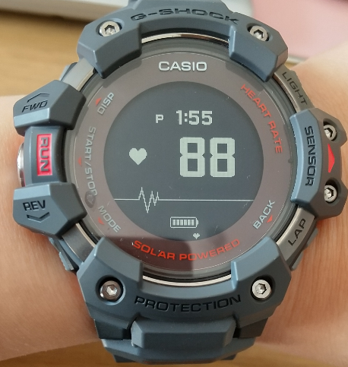
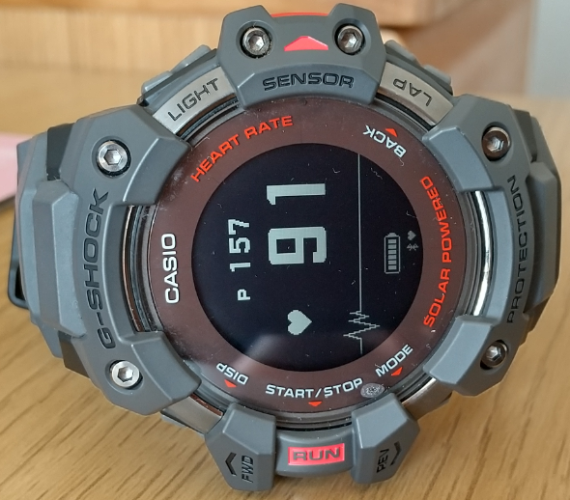
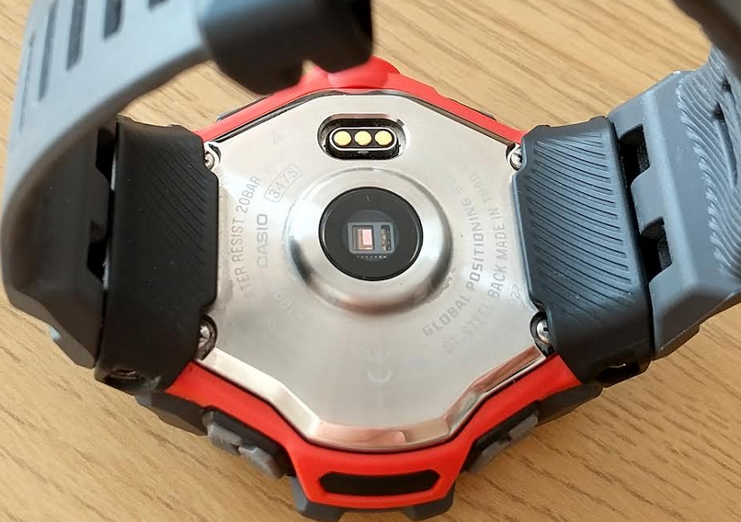
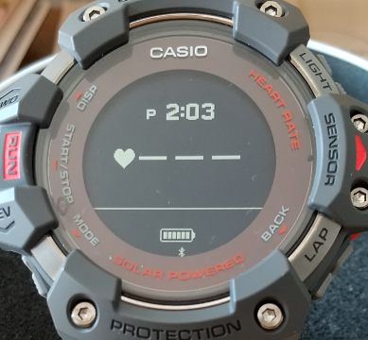
Precautions when measuring Heart Rate
19
●The heart rate monitor keeps measuring even if you remove the watch from your arm.
Whether or not the watch was removed from the wrist
is judged by the movement of the watch (executed for about 90 seconds).
Therefore, even if you remove the watch, the value will change for the time in response to the
light components of the environment.
If the status is as follows, the measurement will be interrupted in about 5 seconds.
Example: The watch is placed with the display surface (glass surface) facing down.
Remove the watch from your arm
About 5 seconds

Slide 20
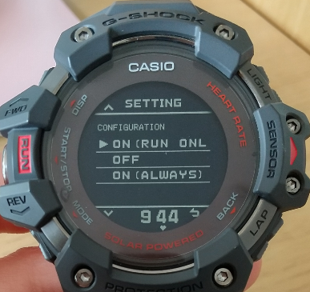
About Calorie Measurement
20
Calorie calculation is done as follows;
When the heart rate sensor is ON ALWAYS or ON (RUN ONLY)
1. Training mode
Calories burned are calculated from the heart rate sensor measurement value
and the user's profile.
2. Other than training mode (When used in timekeeping, heart rate, timer, stopwatch mode, etc.) Calorie consumption calculation by accelerometer
* Both include basal metabolism on the app.
●When the calorie value is strange
If it is in other than training mode, please change to the measurement in training mode. If you are measuring in training mode, please check if the heart rate sensor is ON (ALWAYS) or ON (RUN ONLY). *If the heart rate sensor is turned off, the calorie consumption will be calculated by the accelerometer,
so in the case of CrossFit, Exercise Bike HITT or Weight training (using dumbbells and barbells) etc, it will be
lower.
In addition, please confirm the band mounting position.
Overtightening the band can compress blood vessels and increase the heart rate.
< Reference URL >
Please see “Precautions When Putting on the Watch” on the following URL.
https://support.casio.com/en/support/information.php?cid=009&pid=925

Slide 21
About Calorie Measurement
21
GBD-H1000
Calorie consumption calculation specifications for each mode based on heart rate measurement settings
* Which device calculates calories
ACM : Measurement by accelerometer
GPS・HR : Calculation by heart rate triggered by GPS speed
ACM・HR : Calculation by heart rate triggered by the speed of the accelerometer

Slide 22
About Calorie Measurement
22
GBD-H1000
Whether calories can be calculated by various activities
※ "GPS reception is completed" is a prerequisite for outdoor activities
〇Possible ×Impossible
Heart rate measurement may not be accurate if noise caused by body movement occurs.
It is possible to accurately measure constant movements such as running and walking or without vigorous arm movements, but it may not be possible to accurately measure violently irregular movements in the case of dance, tennis, and CrossFit.
(Heart rate cannot be measured accurately = calorie consumption value is inaccurate)

Slide 23
Precautions for indoor exercise
23
Basically, this application was designed for use when running and walking outdoors.
It can be used for other activities, but some features may not be available or may be less accurate.
Heart rate training is possible in training mode.
In addition, VO2max is calculated by measuring speed and heart rate based on acceleration.
Acceleration-based speed is corrected based on data collected when running outdoors with GPS, so if your running style is the same as when running outdoors, it will be the same as when you run outside.
There is, however, the possibility that your running style will change when using a treadmill or similar apparatus, so accuracy may suffer a little.
Training effects, training load, recovery time, and calories burned are calculated based on heart rate information.
Even in training mode, we confirmed that calories burned are not output if the accelerometer does not detect any movement.
Indoor cycling may not be able to detect the movement of the accelerometer.
In the case of weight training, there is also a possibility that calories burned did not come out because there was little movement per unit time.
Indoor running
Weight training
Indoor Cycling

Slide 24
About Tide Table
24
(GBX-100)
[*harmonic constant]
The tidal force is the effect of the gravitational pull of celestial bodies (moon and sun).
The movement of celestial bodies is complex, but most of them are periodic, so the tidal force can be expressed as the sum of trigonometric functions of various cycles.
The tidal component represented by the trigonometric functions of each period is called the tide. And, the values of the amplitude and the retardation (the delay in the vibration of the tide with respect to the periodic motion of the celestial body) included in the trigonometric function, are called the harmonic constants.
--- From the Japan Meteorological Agency website
It‘s not the case that the tide display of the watch displays
a database of things like the tide table published
by the Japan Meteorological Agency. It uses various parameters such as port position information
and harmonic constant* to calculate the high tide time,
low tide time and tide level.
If there is a database, it can display information without
any deviation with a simple mechanism, but it is impossible
to realize it with a small microcomputer such as a watch,
so we have adopted such a method.
Furthermore, the calculation formula is also very complicated, so considering the processing power of the microcomputer, it is necessary to simplify a part of the calculation to some extent (rounding the value, etc.). Due to this, depending on the port and date and time, the tide table display may have an error of up to 60 minutes compared to the UKHO site.
This is about ports that calculate using harmonic constants with 60-minute tides , and there are some areas calculating with 4-minute tides due to lack of information. Furthermore, in the case of the location set by “USER”, the above parameters cannot be specified, so it is calculated by a slightly simpler calculation method not the
tide calculation.
Therefore, further errors will inevitably occur.

Slide 25
25
When escalating to the head office, please let us know the following.
<Basic confirmation items>
Country name in which the problem is occurring
Watch model name
App name and app version
Smartphone model and OS version
Watch software version (only GBD-H1000、GBD-100、GBX-100）
<Necessary items depending on the contents>
Screenshot when an error occurs
Frequency of occurrence
Whether you have already confirmed the following points to customers
- Uninstall the app and reinstall the app
- Turn off the smartphone and turn it on again
- Turn off the Bluetooth and turn it on again
- Clear the app cache
- Clear the pairing information
- Check power saving settings
- Check Wifi environment or network environment

